Slide 1


Slide 2


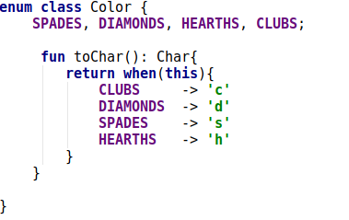
What is Kotlin?
  Programming Language
  Created by Jetbrains
  Released in 2016
  Compiles to Java compatible bytecode
  Object oriented and Functional

Slide 3
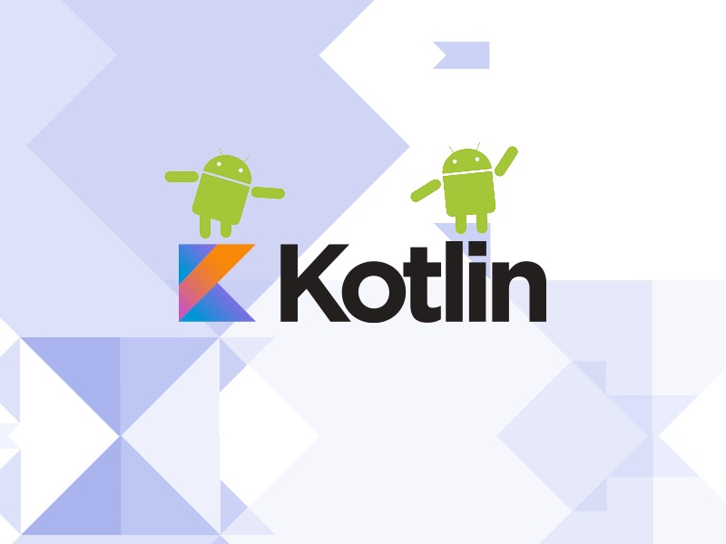
What is Kotlin used for?
Fully compatible with Android.
Because it compiles to JVM, it is compatible with existing java code.
Can be used for everything java is used for.

Slide 4

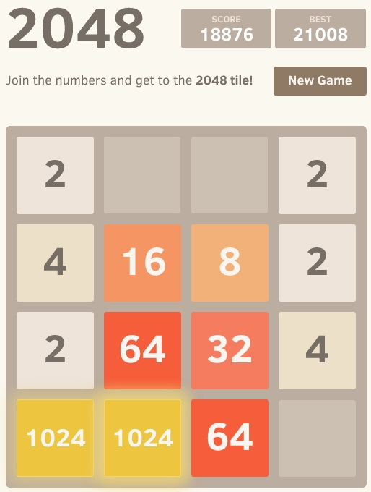

What we have done until now?
Getting comfortable with the Kotlin syntax.
Implemented some algorithms from the INF234 course using Kotlin
Solved the 2048 problem on Kattis using Kotlin.
Set up a Android-Studio Project using Kotlin as back-end.
Implemented entities and some logic for a Blackjack application.

Slide 5


How we intend to do proceed?
Finish The Blackjack android application
Create Kotlin REST-service for highscores and communication between app and server
Ktor, Kotlin web backend

Slide 6
Sources and references
Images:
  https://kotlinlang.org/assets/images/twitter-card/kotlin_800x320.png
  https://developer.android.com/images/home/kotlin-android.svg
  https://open.kattis.com/images/kattis/judge.png?7f7dbf
  https://open.kattis.com/problems/2048/file/statement/en/img-0001.jpg
  https://upload.wikimedia.org/wikipedia/commons/3/33/Blackjack21.jpg
  https://cdn.worldvectorlogo.com/logos/kotlin-2.svg
  http://blog.safedk.com/wp-content/uploads/2017/01/kotlin_blog_img.jpg

